Slide 1
FUEL CONSUMPTION ANALYSIS
DONE BY
ROHIT M(210701215)
SANTHOSH M(210701233)

Slide 2
abstract
This project analyzes fuel consumption and CO2 emissions data from various vehicle models using machine learning algorithms such as decision trees and random forests. Through exploratory data analysis and model building, insights into the factors influencing fuel consumption and emissions are gained. The study employs techniques like feature engineering, hyperparameter tuning, and evaluation metrics to optimize model performance. Results demonstrate the effectiveness of machine learning in predicting fuel consumption and CO2 emissions, contributing to environmental sustainability efforts in the automotive industry. Future research may focus on expanding the dataset and exploring additional predictive features for enhanced modeling accuracy.

Slide 3
PURPOSE OF THE PROJECT
Cost effective as no need to purchase individual sensors for each vehicle as it is done as an ML project.
ML models can be deployed for a no of vehicles without the need for individual sensors in each vehicle.
ML models can adapt to various vehicle types, driving conditions, and environmental factors.
ML models can forecast fuel efficiency based on historical data and current conditions.

Slide 4
EXISTINGT SYSTEM
The existing system employs various regression techniques, including linear regression, ridge regression, and lasso regression, for predicting vehicle fuel consumption. These regression methods are commonly used in data analysis and provide insights into the relationships between independent variables (vehicle attributes) and the dependent variable (fuel consumption).The existing system employs various regression techniques, including linear regression, ridge regression, and lasso regression, for predicting vehicle fuel consumption. These regression methods are commonly used in data analysis and provide insights into the relationships between independent variables (vehicle attributes) and the dependent variable (fuel consumption).

Slide 5
PROPOSED SYSTEM
This project suggests Fuel Consumption analysis based on machine learning (ML). The machine learning algorithm is able to predict fuel usage with high accuracy by utilizing pre-existing datasets that contain characteristics like driving habits, vehicle type, and environmental conditions. Furthermore, the model offers predictive and analytical capabilities in real-time, allowing for proactive efforts to improve fuel economy. Our results show that ML models can be a good substitute for conventional sensor-based techniques, offering accurate predictions at a lower cost and complexity.

Slide 6
TECHNOLOGIES USED
Scikit learn
Streamlit
Pandas
Pickle
Seaborn

Slide 7
Data preprocessing steps
Drop unnecessary columns
Replacing null values of Fuel Type with mode value.
Reduced noise in Transmission column.
Univariate Analysis
Bivariate Analysis
Ordinal Encoding

Slide 8
ALGORITM USED
A decision tree is a predictive modeling tool that learns a series of hierarchical decision rules based on the features in the dataset.
1. Root Node: The algorithm starts by selecting the feature that best separates the entire dataset. This feature becomes the root node of the tree. - For example, it might find that "Engine Size(L)" is a good initial split.
2. Splitting Criteria: - At each internal node (including the root), the dataset is split into subsets based on a specific feature and a threshold value. - The splitting decision is made by identifying the feature and threshold that best separates the data, usually to minimize variance or maximize information gain.
3. Child Nodes: - The dataset is divided into subsets, and for each subset, the process is repeated recursively, creating child nodes. - For instance, one branch might represent vehicles with an engine size smaller than a certain threshold, and another branch might represent vehicles with a larger engine size.
4. Leaf Nodes: - The process continues until a stopping condition is met. This could be a predefined depth of the tree, a minimum number of samples in a node, or other criteria. - The final nodes, called leaf nodes, contain the predicted output. In a regression task like predicting fuel consumption, each leaf node might represent an estimated fuel consumption value.
5. Prediction: - To make a prediction for a new data point, it traverses the decision tree from the root to a leaf node based on the feature values of the data point. - The predicted value at the leaf node becomes the model's output.

Slide 9
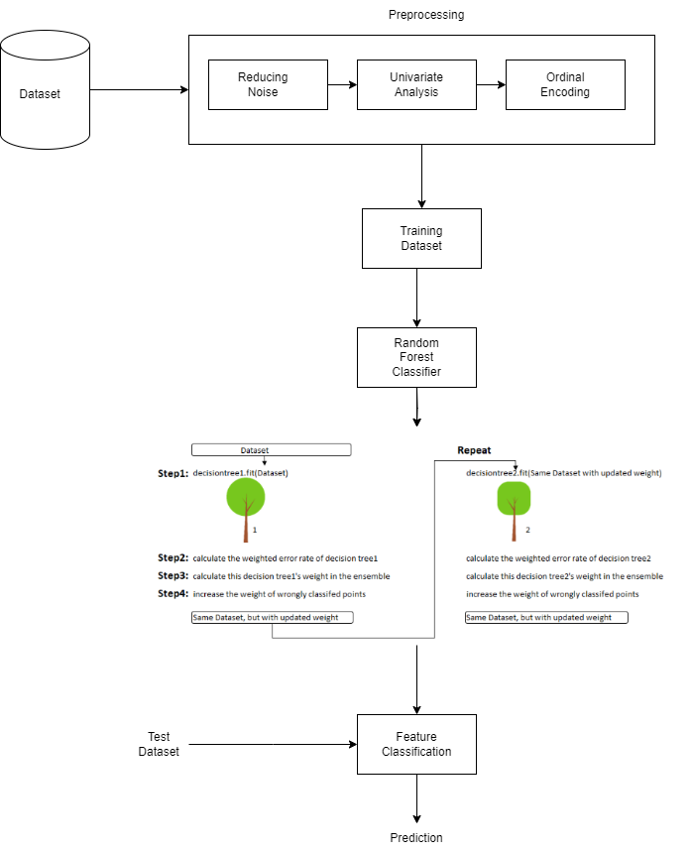
System architecture

Slide 10
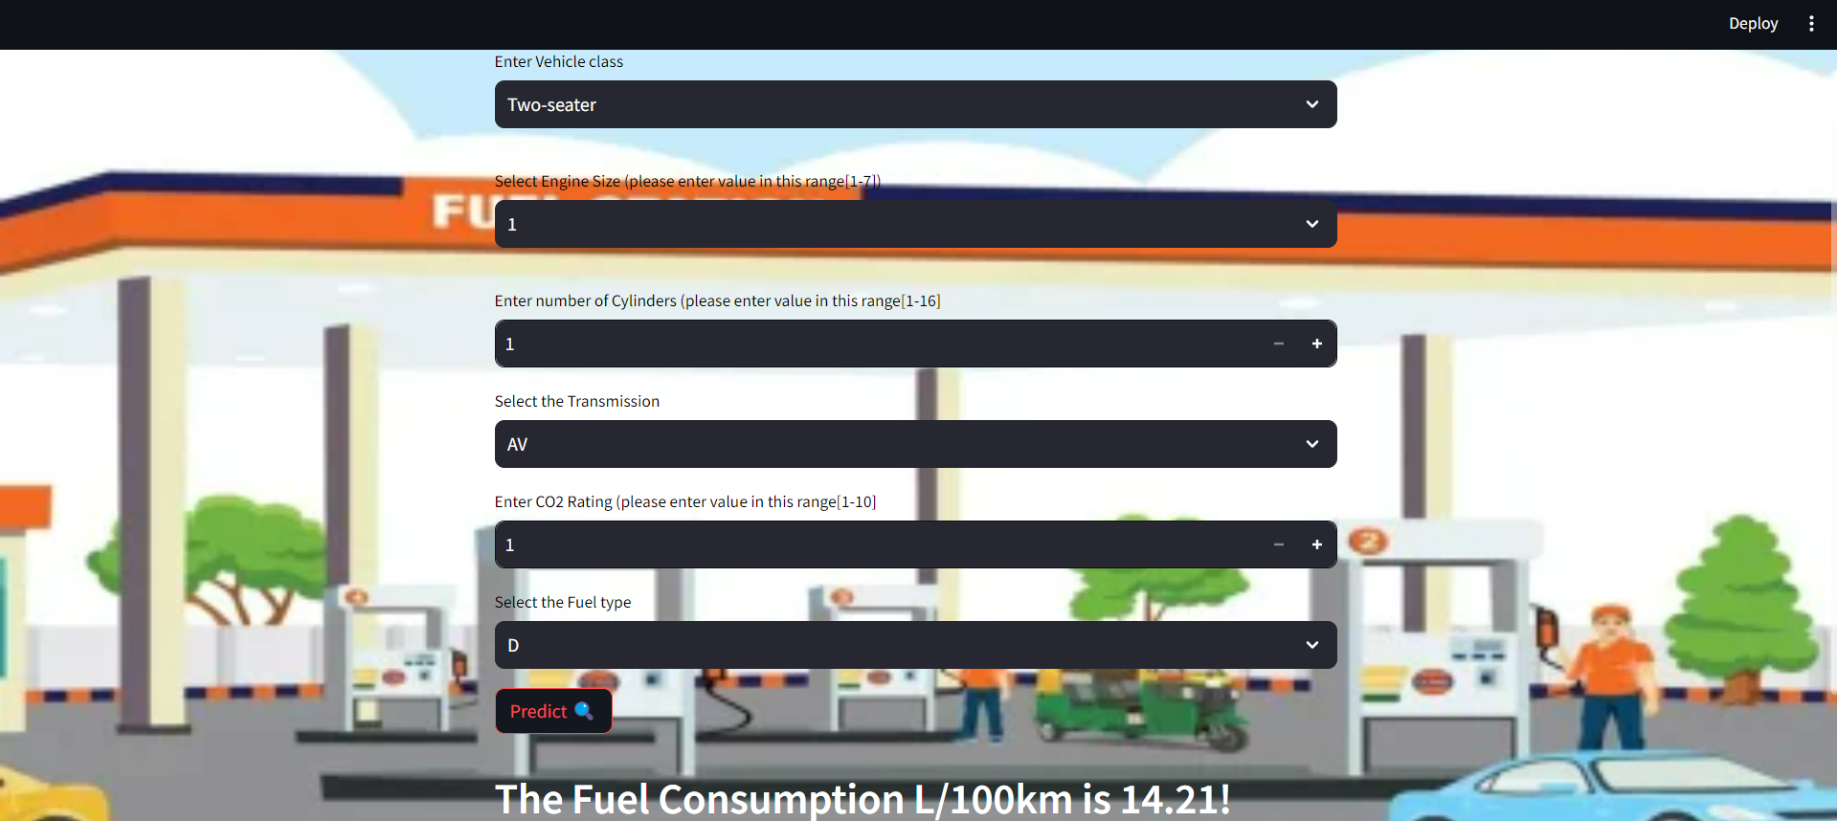
Output

Slide 11
CONCLUSION
In this project, we aimed to develop a fuel efficiency prediction system using a random forest classifier through meticulous data preprocessing steps including dropping unnecessary columns, handling missing values, reducing noise, and encoding categorical variables, we prepared the dataset for model training.
The utilization of features such as the number of cylinders, transmission mode, fuel type, engine size, and CO2 rating allowed the random forest classifier to effectively capture the complexities influencing fuel consumption. By leveraging the ensemble of decision trees and the randomness in feature selection, the model exhibited robustness and accuracy in predicting fuel efficiency across diverse vehicle types and driving conditions.

Slide 12
FUTURE ENHANCEMENT
Incorporating more advanced feature engineering techniques can help extract additional insights from the data. For example, deriving new features based on domain knowledge or employing dimensionality reduction methods to capture underlying patterns more effectively could enhance the model's predictive power.
Furthermore, continuous model monitoring and evaluation are essential to identify and address any performance degradation over time. Implementing robust validation techniques and periodic retraining of the model with updated data can ensure that it maintains its accuracy and relevance in evolving real-world scenarios.

